Slide 1
Automating Fabric Solution Deployment Guidance and Best Practices with CI/CD for Deploying and Updating Fabric Solutions

Slide 2
Agenda
Introduction to Fabric Solution Deployment
Challenges in Fabric Solution Deployment
Implementing Workflows to Deloy Fabric Solutions
Integrating Deployment Parameters into CI/CD Workflows
Deploying and Updating Solutions from a Source Workspace
Implementing CI/CD using Staged Deployments
Managing Item Definitions using Fabric GIT Integration

Slide 3










Workspaces with Sample Fabric Solution Scenarios
Fabric Power BI Solution
Fabric Lakehouse Solution with Notebook
Fabric Lakehouse Solution with Shortcut and Notebook
Fabric Lakehouse Solution with Data Pipeline and Notebooks
Semantic Model
Report
Lakehouse
Notebook
Semantic Model
Report
Lakehouse
Shortcut
Notebook
Semantic Model
Report
Lakehouse
Notebook
Data Pipeline
Semantic Model
Report

Slide 4
Workspace Item Types
Fabric solutions designed and implemented in terms of workspace items
Developers can discover, create and manage workspace items inside scope of a workspace
Workspace items are created and updated using item definitions
Creatable Workspace Item Types by Workload
Data Engineering
Power BI
Data Warehouse
Data Factory
Real-time Intelligence
Data Science
Lakehouse
SemanticModel
Warehouse
DataPipeline
Eventhouse
MLExperiment
Notebook
Report
MirroredWarehouse
Dataflow
Eventstream
MLModel
SparkJobDefinition
KQLDatabase
Environment
KQLQueryset
KQLDashbord

Slide 5
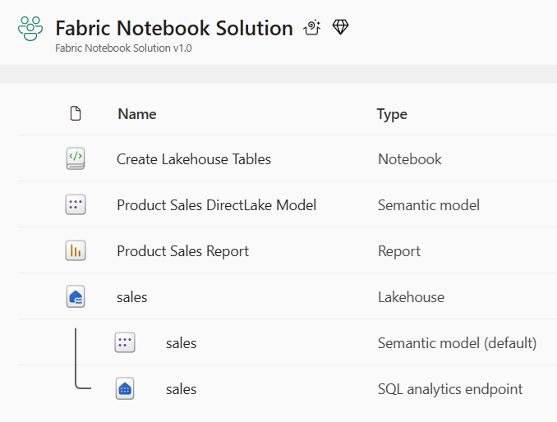
Developing Workflows to Deploy and Update Solutions
Deploy workflow creates new target workspace and clones source workspace items
Deploy workflow always creates target workspace and builds it from scratch
Fabric REST APIs provide necessary CRUD APIs for managing workspace items
Update workflow processes set of updates on target workspace that already exists
Source workspace items that already exist in target workspace are updated
Source workspace items that do not already exist in target workspace are created
Source Workspace
Target Workspace
Deploy
Items
Source Workspace
Target Workspace
Update
Items

Slide 6
First Motivation for Automating Deployment
Staged deployment used to push changes between environments like DEV>TEST >PROD
DEPLOY workflow creates downstream workspaces on demand
UPDATE workflow pushes out full update to all workspace items or partial update
DEPLOY and UPDATE workflows can cross environments such as Entra Id tenant boundaries
Building each stage requires configuring different datasource paths
DEPLOY workflow for must configure datasources differently for DEV, TEST and PROD
Entra Id tenant A
Entra Id tenant B
Entra Id tenant C
Dev Workspace
Test Workspace
Deploy
Items
Prod Workspace
Deploy
Items
Update
Items
Update
Items

Slide 7

Second Motivation for Automating Deployment
Fabric provides development platform for building multi-tenant applications
Each customer tenant created using one or more Fabric workspaces
Developer uses Fabric REST APIs to create and configure workspaces and workspace items
Fabric Multi-tenant Environment
Entra Id Tenant Owned by ISV
Customer 1 Tenant Workspace
Customer 01
17 users
Lakehouse
Notebook
Semantic Model
Report
Custom
Multitenant Application
Customer 2 Tenant Workspace
Lakehouse
Notebook
Semantic Model
Report
Customer 02
85 users
Customer N Tenant Workspace
Lakehouse
Notebook
Semantic Model
Report
Customer N
450 users

Slide 8
Designing a Solution Template for a Fabric Solution
Design workspace to serve as solution template to provision customer tenants
Implement DEPLOY workflow to create workspaces from Fabric solution template
Execute deployment workflow to create customer tenants
Deployment must support parameterization of unique customer data (e.g. datasource paths)
Customer 1
Workspace
Fabric Solution Template
Solution Deployment Logic
Customer 2
Workspace
Customer 3
Workspace

Slide 9
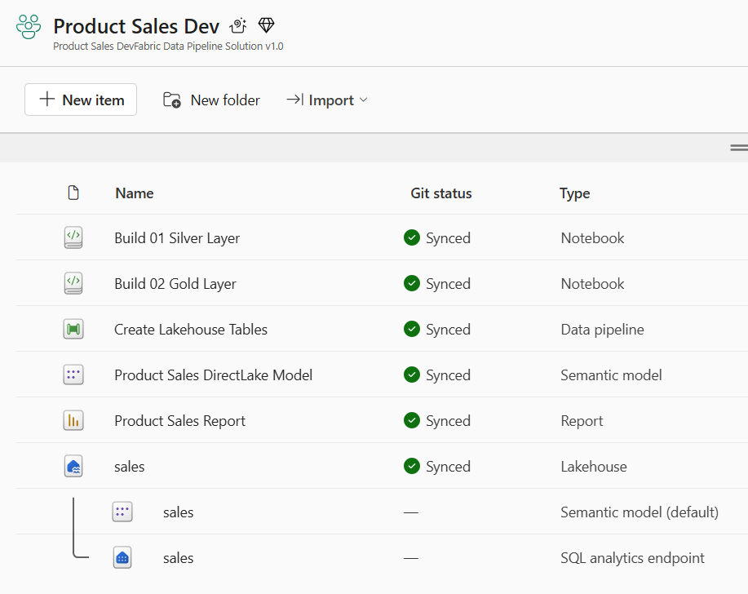
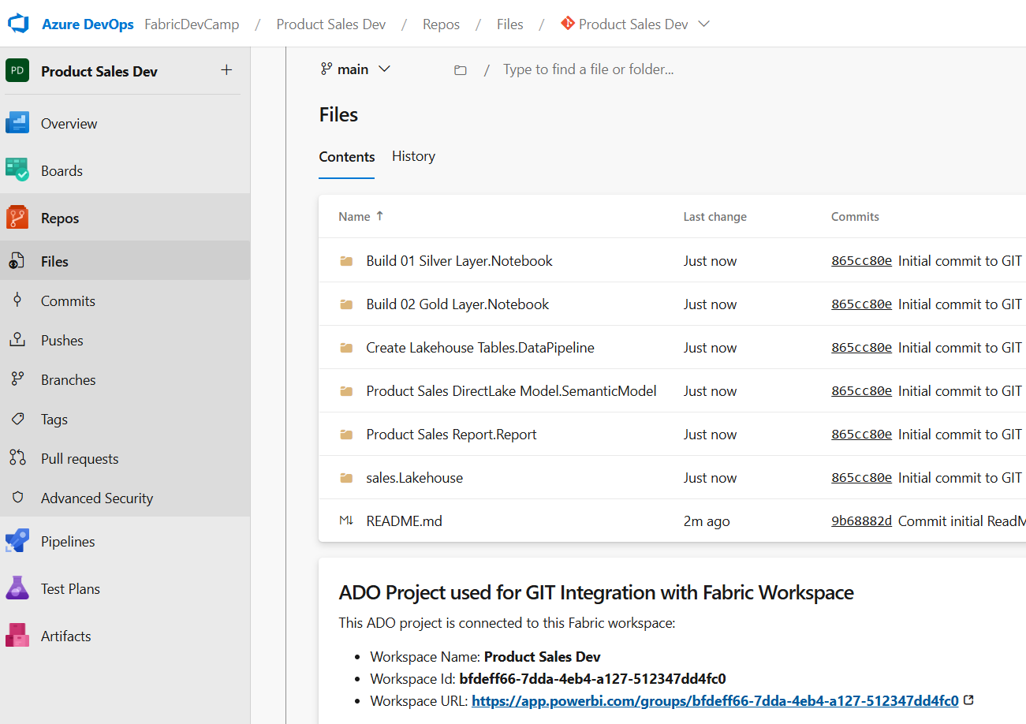
Connecting Fabric Workspace to GIT Repositories
Fabric workspace can be connected to GIT repository
Fabric currently supports GIT repositories in Azure Dev Ops and GitHub
Workspace connections can be configured by hand or through Fabric REST APIs
Once connected, workspace items serialized as item definition files in GIT repository
GIT connection to workspace provides 2-way synchronization
Changes made to workspace items can be synchronized to GIT repository files
Changes committed to GIT repository files can be synchronized to workspace items
GIT
Sync

Slide 10
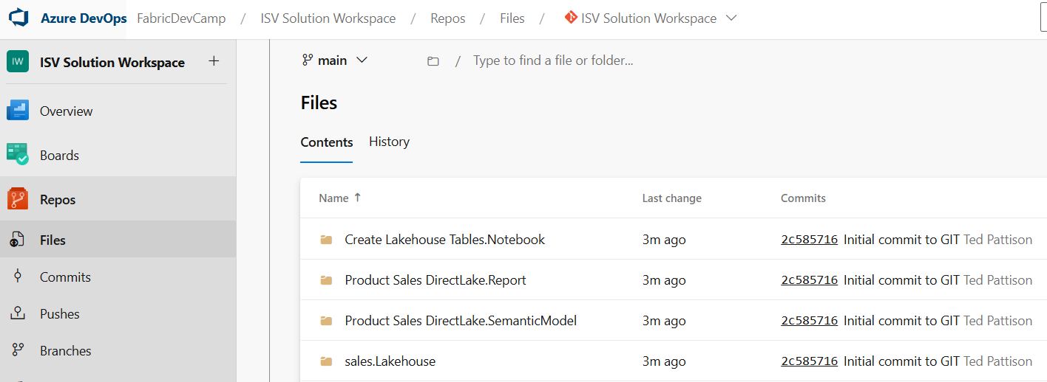
Fabric CI/CD for Enterprise Scenarios
Dev Workspace
Test Workspace
Prod Workspace
Deploy
or
Update
Deploy
or
Update
GIT
Sync

Slide 11
Fabric CI/CD for Multitenancy Scenario
Customer 1 Workspace
Deploy
or
Update
Dev Workspace
Test Workspace
Deploy
or
Update
Prod Workspace
Customer 2 Workspace
Deploy
or
Update
Deploy
or
Update
Deploy
or
Update
GIT
Sync
Customer N Workspace

Slide 12
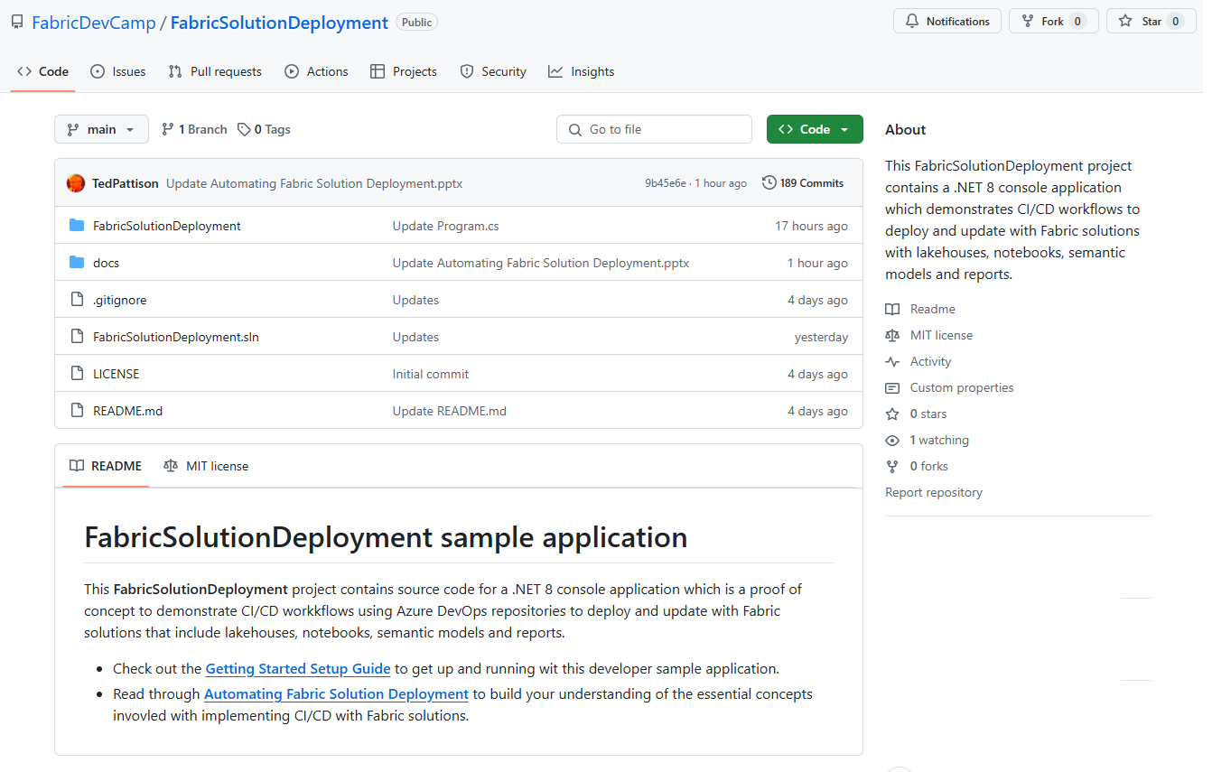
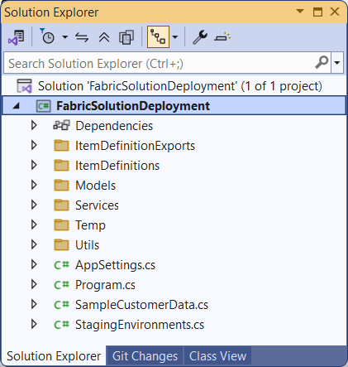
The FabricSolutionDeployment Developer Sample
Sample application demonstrating how to implement solution deployment workflows
Created as a .NET 8 console application using the Fabric REST API .NET SDK
Provides easy learning path for developers to download project and get up and running
https://github.com/FabricDevCamp/FabricSolutionDeployment

Slide 13
Sequence of Lab Exercises
Sequence of lab exercises when testing FabricSolutionDeployment project
Lab 01: Deploy Solution From Item Definitions
Lab 02: Export Item Definitions From Workspace
Lab 03: Deploy with Parameterized Datasource Paths
Lab 04: Deploy Solution From Source Workspace
Lab 05: Update Solution From Source Workspace
Lab 06: Setup Staged Deployment
Lab 07: Push Solution Updates to Production
Lab 08: Connect Dev Workspace to GIT Repository
Lab 09: Export Workspace to Packaged Solution Folder
Lab 10: Deploy and Update from Solution Package Folder

Slide 14
Agenda
Introduction to Fabric Solution Deployment
Challenges in Fabric Solution Deployment
Implementing Workflows to Deloy Fabric Solutions
Integrating Deployment Parameters into CI/CD Workflows
Deploying and Updating Solutions from a Source Workspace
Implementing CI/CD using Staged Deployments
Managing Item Definitions using Fabric GIT Integration

Slide 15
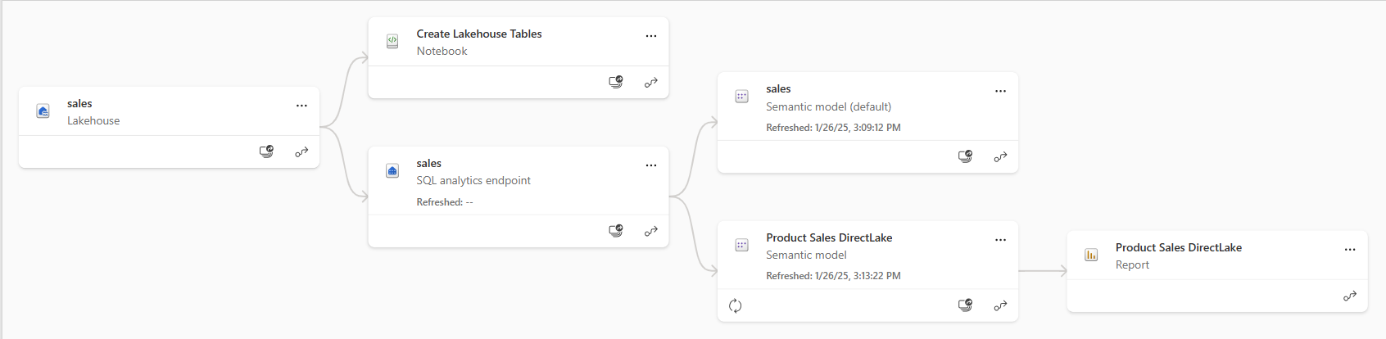
Understanding Workspace Item Dependencies
Many workspace items have dependencies on other workspace items
Notebook definition depends on workspace id and lakehouse id to reference its default lakehouse
DirectLake semantic model definition depends on connection string to SQL endpoint of lakehouse
Report definition depends on semantic model id
After deployment, solution should not have dependencies on other workspaces
All dependencies should be self-contained in new workspace
Fabric solution deployment requires custom logic to update dependencies accordingly

Slide 16
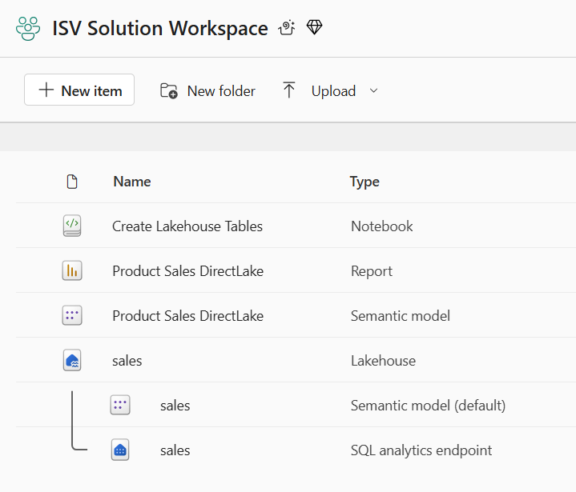
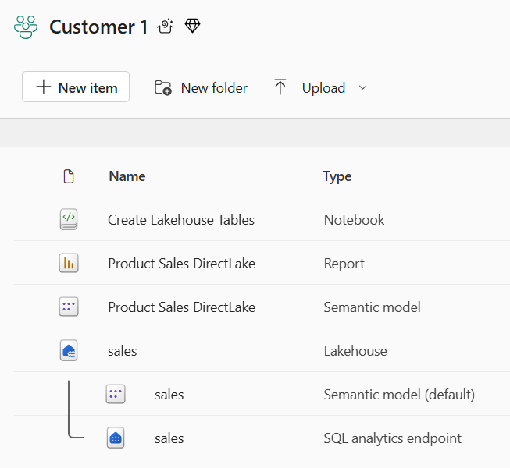
Creating Workspace Items with Dependencies
Deployment workflow must create workspace items with dependencies last
Notebook definition depends on lakehouse id for its default lakehouse
DirectLake semantic model definition depends on connection string to SQL endpoint of lakehouse
Report definition depends on semantic model id
Shallow copy of template workspace is not the result you want
Workspace for customer tenant should not have dependencies on soure workspace
Source Workspace
Target Workspace

Slide 17
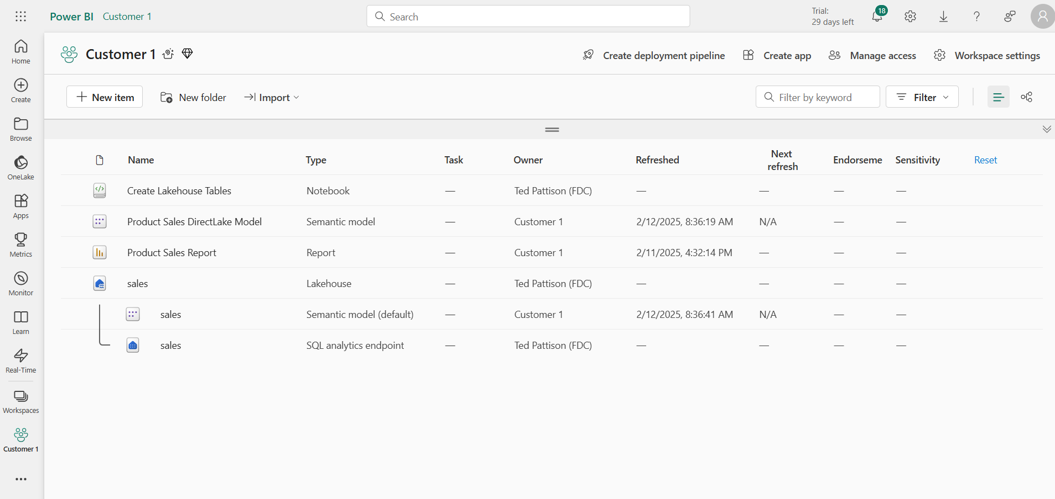
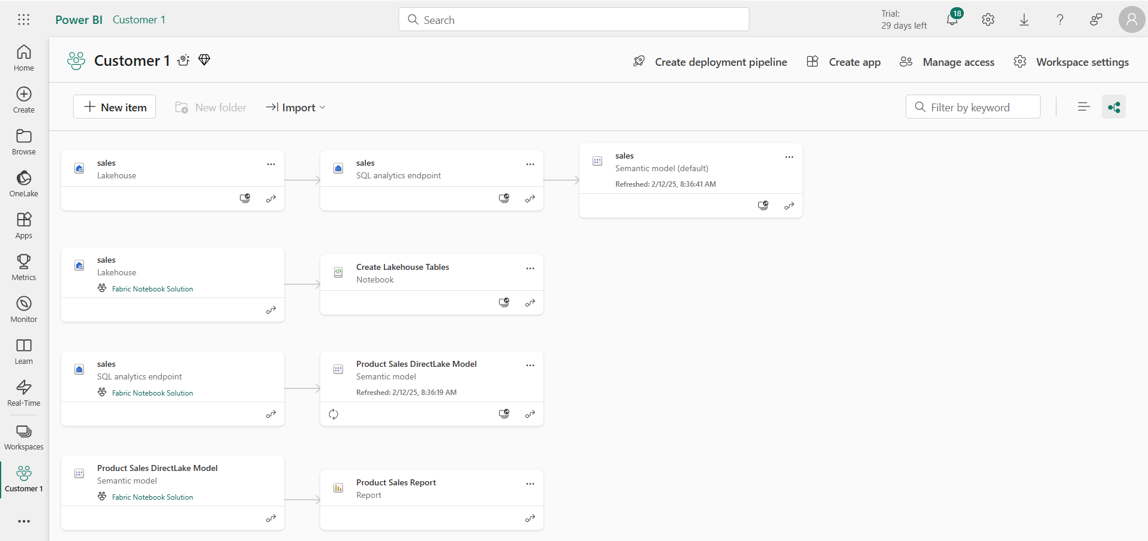
This deployment result IS NOT what you want
Checking for intra-workspace dependencies
Navigate to Lineage view to see item dependencies
Look for items that have dependencies on items in other workspaces

Slide 18
Challenge of Managing Connections at Workspace Scope
Unlike workspace items, connection items are scoped at level of Entra Id tenant
No API support for workspace-level management of connections
Developer must find innovative approach for handling connections
Platform Item Types
Capacity
Workspace
Connection
Gateway
Workspace Item Types by Workload
Power BI
Data Engineering
Data Warehouse
Data Factory
Real-time Intelligence
Data Science
SemanticModel
Lakehouse
Warehouse
DataPipeline
Eventhouse
MLExperiment
Report
Notebook
MirroredWarehouse
Dataflow
Eventstream
MLModel
SparkJobDefinition
KQLDatabase
Environment
KQLQueryset
KQLDashbord

Slide 19
Agenda
Introduction to Fabric Solution Deployment
Challenges in Fabric Solution Deployment
Implementing Workflows to Deloy Fabric Solutions
Integrating Deployment Parameters into CI/CD Workflows
Deploying and Updating Solutions from a Source Workspace
Implementing CI/CD using Staged Deployments
Managing Item Definitions using Fabric GIT Integration

Slide 20
Programming with Fabric Item Definitions
Fabric items can be created and updated using item definitions
You can pass item definition when calling Create Item API
You can modify existing workspace item by calling Update Item Definition passing item definition
You can retrieve item definition for existing workspace item by calling Get Item Definition
Your Application
Fabric REST APIs
Item
Definition
POST - Create Item
Item
Definition
POST - Update Item Definition
Item
Definition
POST - Get Item Definition

Slide 21
Sequence of Deployment Steps in Power BI Solution
Create DirectLake semantic models
Create imported semantic model using updated item definition
Track semantic model id for later use
Create Web connection with same location as semantic model
Bind connection to semantic model
Refresh semantic model
Create Power BI reports
Create report using updated item definition that includes semantic model id

Slide 22
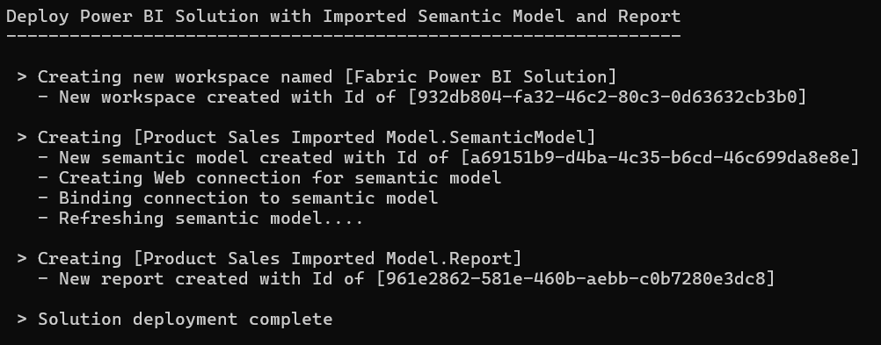


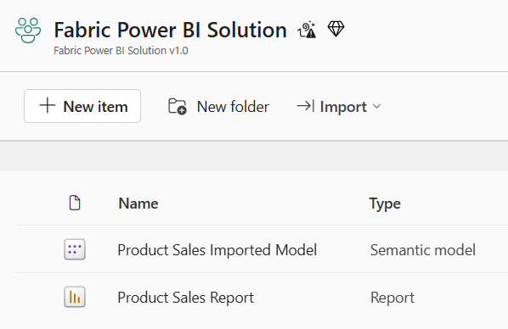
Deploy the Power BI Solution
Workspace (Power BI solution)
Semantic Model
Report

Slide 23
Creating and Binding Connection to Semantic Model

Slide 24
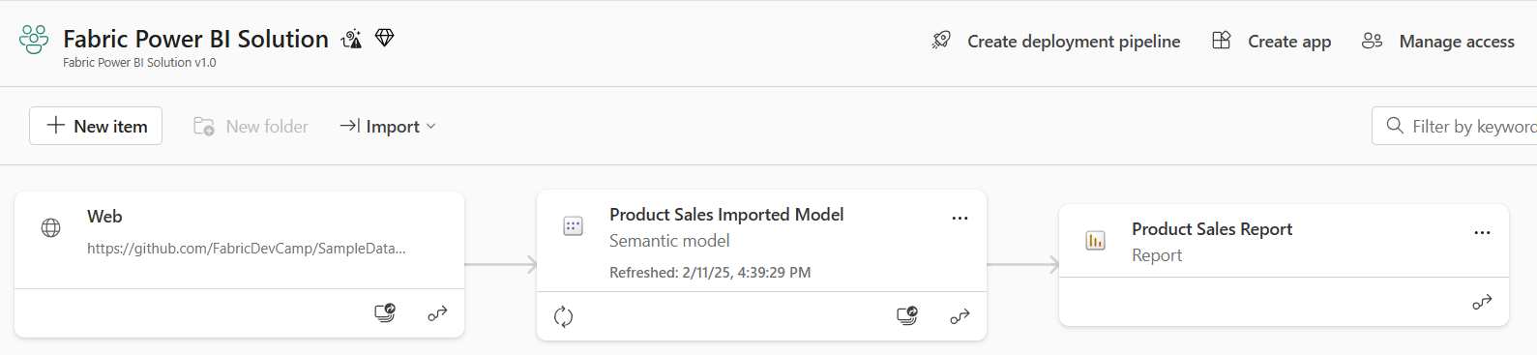
Power BI Solution Post Deployment
All dependencies are self-contained within the new workspace
There are no dependances on workspace items in other workspaces

Slide 25
Sequence of Deployment Steps in Notebook Solution
Create lakehouses
Lakehouse has no dependencies on other workspace items
After creation, track lakehouse id for later use
Query lakehouse properties to discover SQL endpoint server connect string and database Id
Create notebooks
Create notebook using item definition that includes workspace id & lakehouse id
Run notebook and monitor execution until completion to create lakehouse table schema
Create DirectLake semantic models
Create semantic model using updated item definition that includes SQL endpoint connect string
After creation, track semantic model id for later use
After creation, create & bind connection and then refresh semantic model (if required)
Create Power BI reports
Create report using updated item definition that includes semantic model id

Slide 26
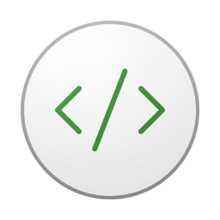

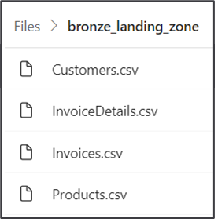
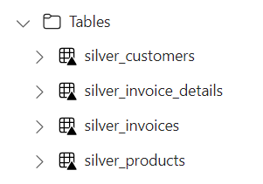
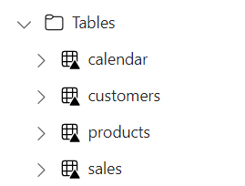


Using Spark Jobs to Create Lakehouse Tables
Custom ISV Application
Customer Tenant Workspace
Environment
Lakehouse
bronze layer
silver layer
gold layer
notebook
Spark job
Spark job
Spark job

Slide 27
Exposing Data to Consumers through the SQL Endpoint
Table data in lakehouse tables accessible through SQL endpoint
SQL endpoint automatically created for lakehouse
SQL endpoint provides read-only access for executing SQL queries
SQL endpoint provides data access to wide range of SQL-based applications
ISV AAD Tenant
Customer Tenant Workspace
SQL-based
Reporting Tools
Lakehouse
SQL Endpoint
SQL-based
Export Utilities
Custom SQL-based Applications

Slide 28
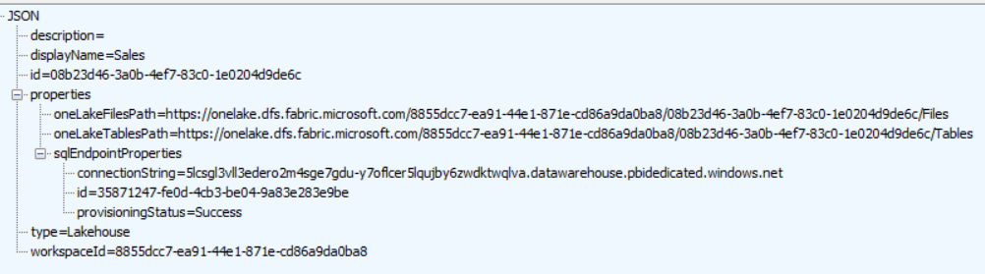
Lakehouse Properties
Retrieve lakehouse properties by executing GET request through /lakehouses endpoint
GET request with target URL of /workspaces/{WORKSPACE_ID}/lakehouses/{LAKEHOUSE_ID}
JSON response provides sqlEndpointProperties data required to create semantic model
Response also contains OneLake path properties used to access lakehouse storage
oneLakeFilesPath property contains path to unmanaged Files section of lakehouse file system
oneLakeTablesPath property contains path to managed Table section of lakehouse file system
Demo6-OnelakeFileWriter shows how to use these paths with ADLS Gen2 APIs to upload files to lakehouse
SQL Connection Info

Slide 29

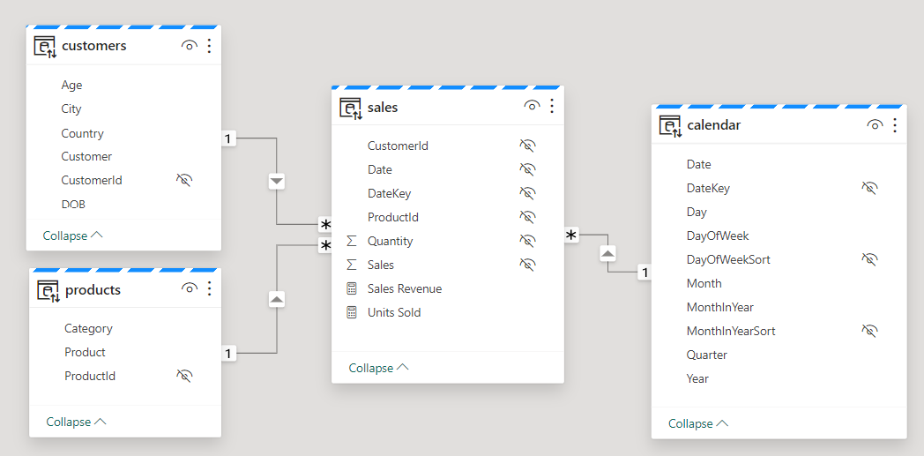
Creating Semantic Models on Lakehouse Tables
Creating semantic model on lakehouse tables uses DirectLake mode
Semantic model created by passing model.bim to Create Item API
Semantic model allow you to define relationships, measures, hierarchies, etc.
CAVEAT: DirectLake semantic models do not support many import-mode features
Customer Tenant Workspace
Lakehouse
Semantic Model (aka Dataset)
SQL Endpoint

Slide 30
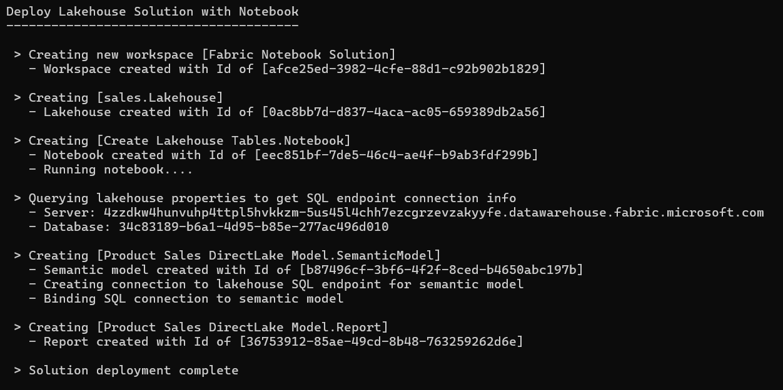




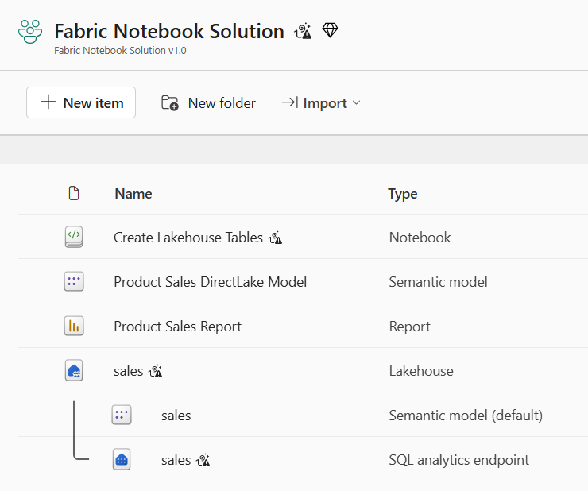
Deploy the Notebook Solution
Workspace (Notebook Solution)
Lakehouse
Notebook
Semantic Model
Report

Slide 31
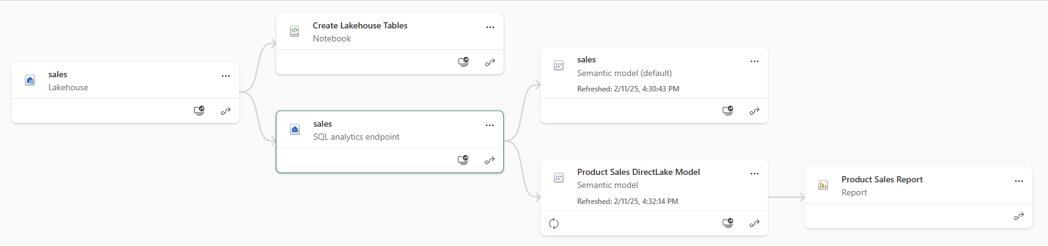
Notebook Solution Post Deployment
All dependencies are self-contained within the new workspace
There are no dependances on workspace items in other workspaces

Slide 32

Custom Application
Fabric Environment
Customer Workspace
OneLake Shortcut
Outbound Security
Connection to external Datasource
ADLS Gen2
Storage Container
Inbound Security
Calls to Fabric REST API
Semantic Model
Outbound Security
Connection to external Datasource
Azure
SQL Database

Slide 33
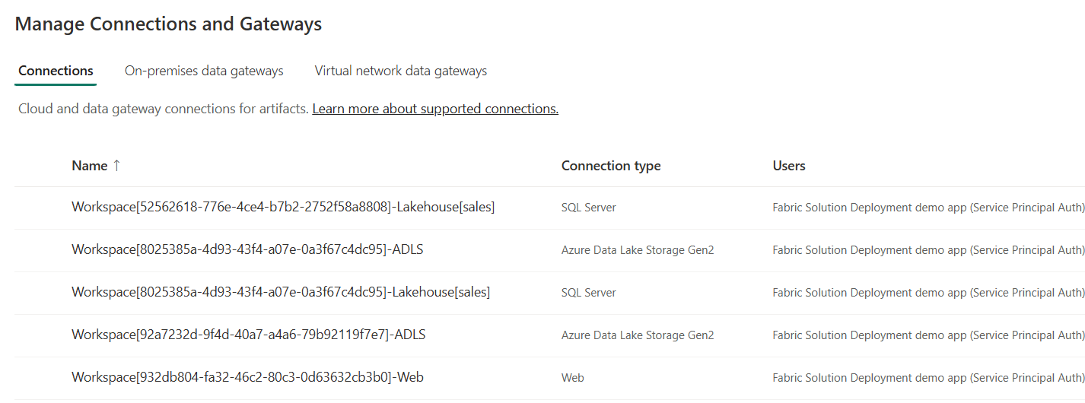
Using a Naing Convention for Managing Connections
ssddd
sswsww
zzz
Workspace[WORKSPACE_ID]-Lakehouse[sales]
Workspace[WORKSPACE_ID]-ADLS
Workspace[WORKSPACE_ID]-Web

Slide 34
Recreating Source Workspace Connections
ddd

Slide 35
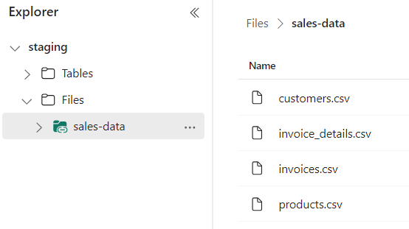
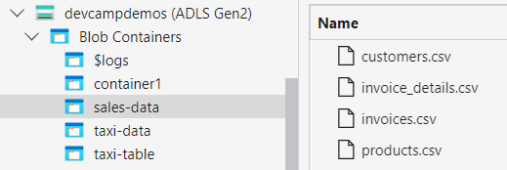
OneLake Shortcut Fundamentals
What is a OneLake shortcut?
A shortcut is an OneLake object that points to another internal or external storage location
Shortcuts can be created in lakehouses and Kusto Query Language (KQL) databases
OneLake supports shortcuts targeting external locations in ADLS storage, Amazon S3 storage and Dataverse
Shortcuts behave like symbolic links
Shortcuts are independent objects from the target source
If you delete a shortcut, the target remains unaffected
If you move, rename, or delete a target path, the shortcut can break
Shortcut acts as pointer to storage location
Shortcut has unique icons

Slide 36
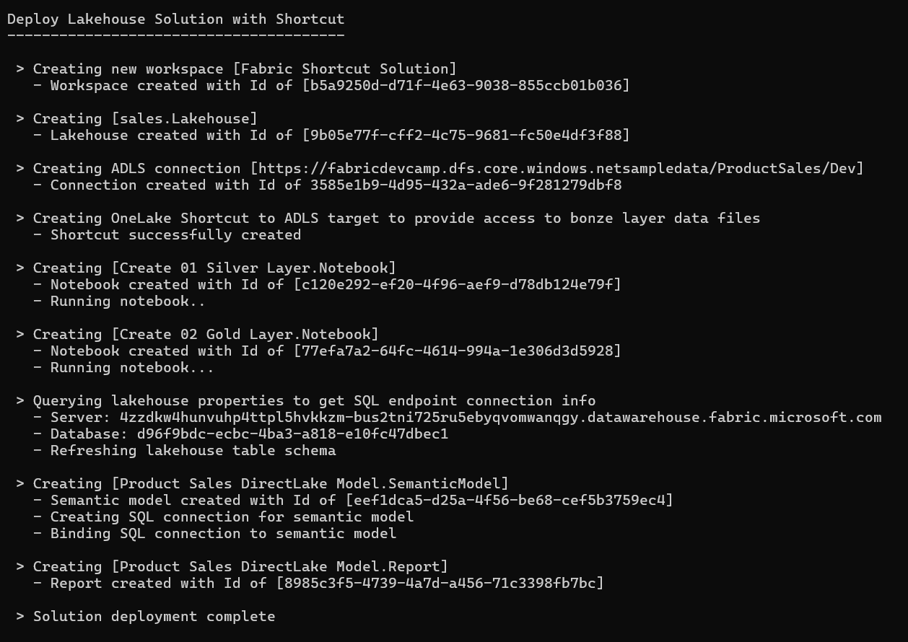





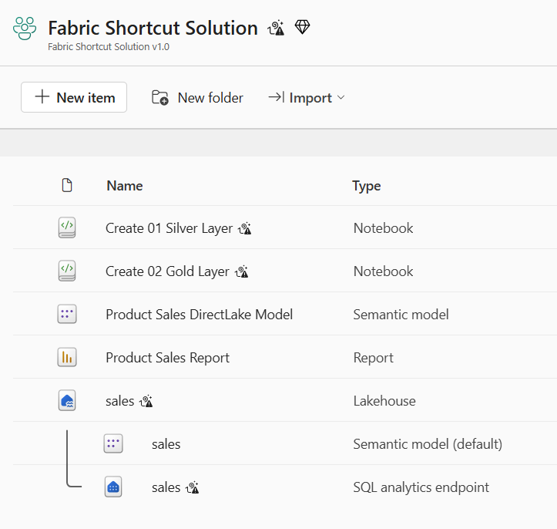
Deploy Shortcut Solution
Workspace (Shortcut Solution)
Lakehouse
Shortcut
Notebook
Semantic Model
Report

Slide 37
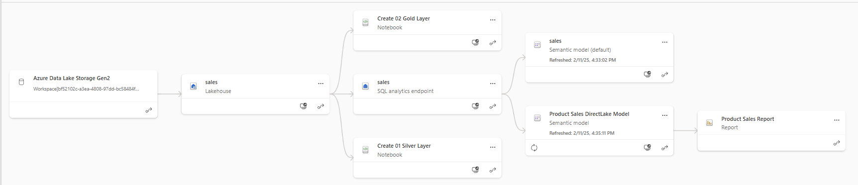
Shortcut Solution Post Deployment
All dependencies are self-contained within the new workspace
There are no dependances on workspace items in other workspaces

Slide 38
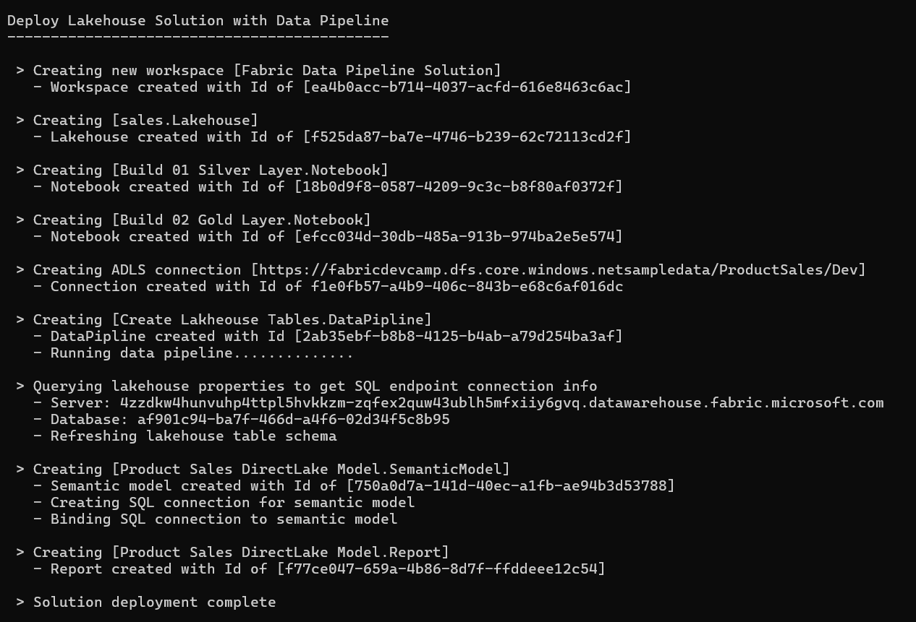





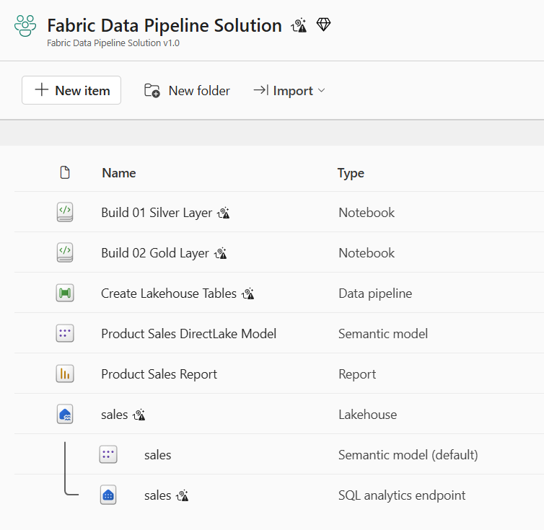
Deploy the Data Pipeline Solution
Workspace (Data Pipeline Solution)
Lakehouse
Notebook
Data Pipeline
Semantic Model
Report

Slide 39
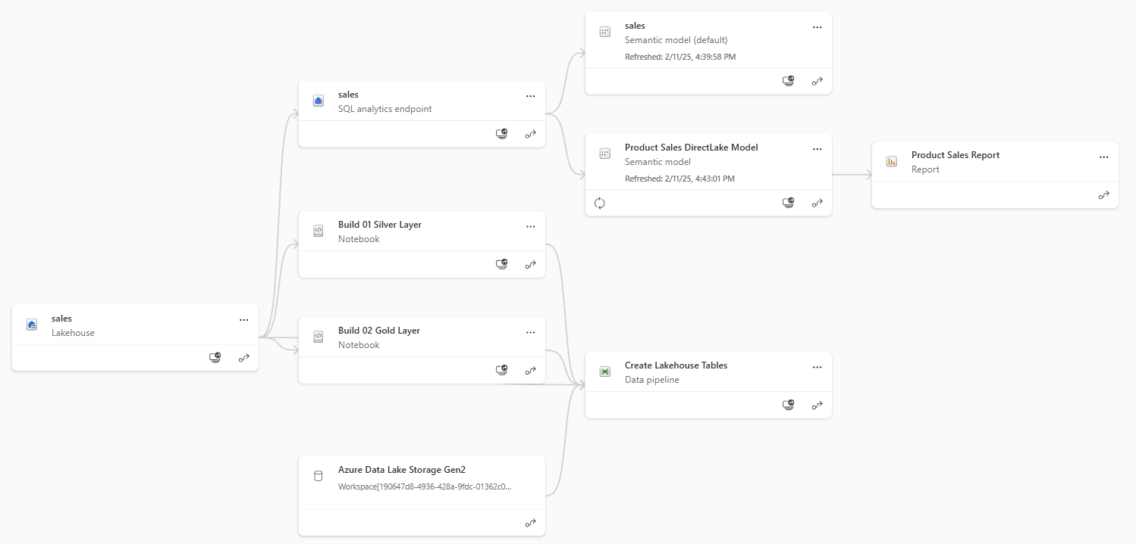
Data Pipeline Solution Post Deployment
All dependencies are self-contained within the new workspace
There are no dependances on workspace items in other workspaces

Slide 40
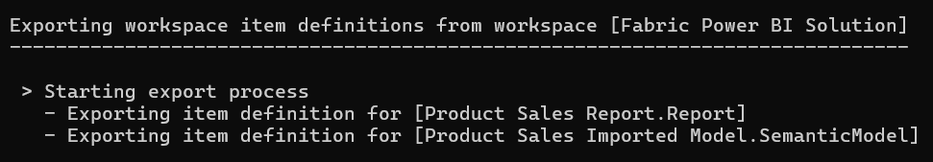
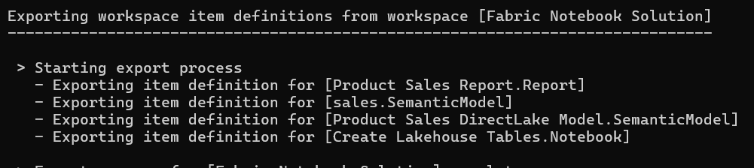
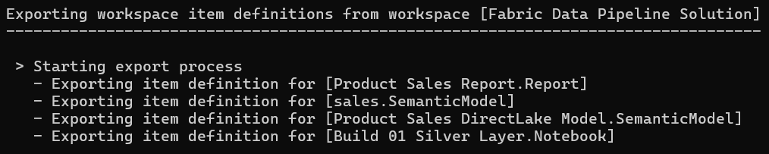
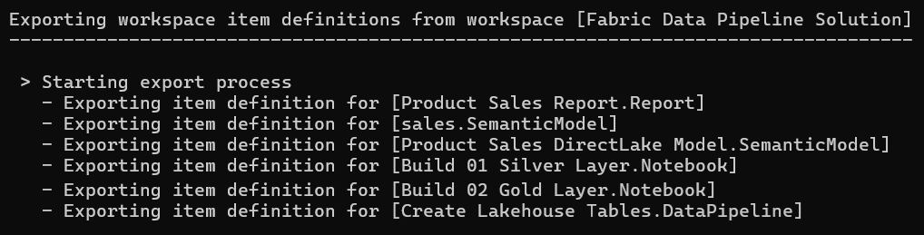
Exporting Workspace Definitions
ss

Slide 41
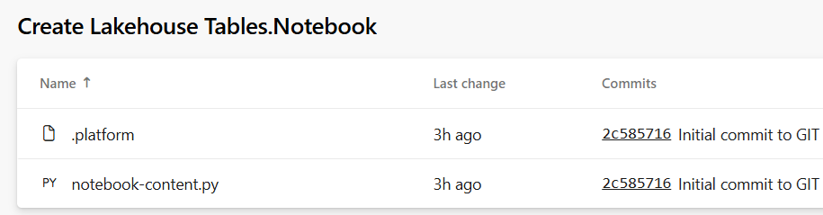
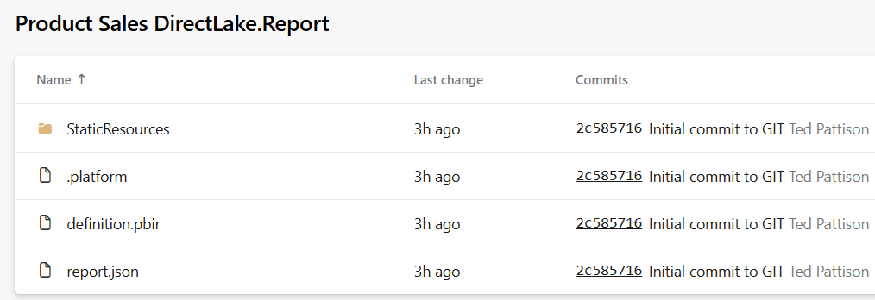
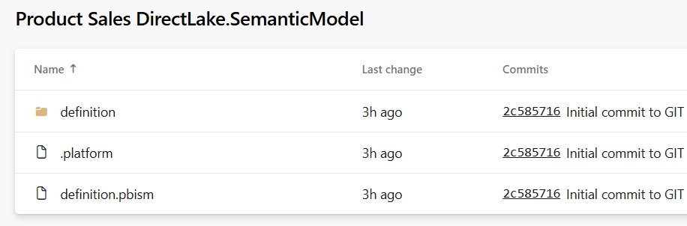
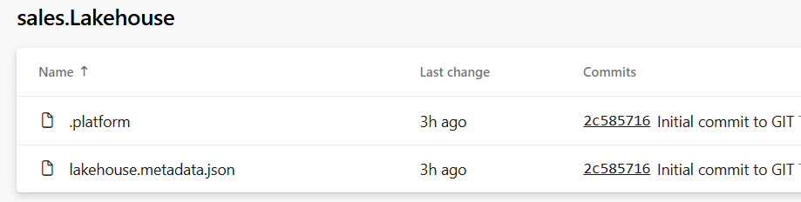
Item Definition Files
Fabric ALM strategy with CI/CD based on item definition files
Fabric automatically serializes workspace items into set of item definition files
Each type of workspace item defines the set of files that constitutes a valid item definition

Slide 42
Agenda
Introduction to Fabric Solution Deployment
Challenges in Fabric Solution Deployment
Implementing Workflows to Deloy Fabric Solutions
Integrating Deployment Parameters into CI/CD Workflows
Deploying and Updating Solutions from a Source Workspace
Implementing CI/CD using Staged Deployments
Managing Item Definitions using Fabric GIT Integration

Slide 43
Parameterizing Datasources in Staged Deployment
Each stage in staged deployment should connect to its own needs datasource paths
DEV and TEST stage workspaces should not connect to same datasources as PROD
Entra Id tenant A
Entra Id tenant B
Entra Id tenant C
Dev Workspace
Test Workspace
Prod Workspace
Deploy
or
Update
Deploy
or
Update
Dev Stage Datasources
Test Stage Datasources
Prod Stage Datasources
ADLS Gen2
Storage Container
Azure
SQL Database
ADLS Gen2
Storage Container
Azure
SQL Database
ADLS Gen2
Storage Container
Azure
SQL Database

Slide 44
Parameterizing Customer Data and Datasource Paths
Solution design required to parameterize customer data
Deployment workflow must integrate creation parameters unique to each customer
This is especially true for datasource path
Customer 1 Datasources
Customer 1
Workspace
ADLS Gen2
Storage Container
Azure
SQL Database
Fabric Solution Template
Solution Deployment Logic
Customer 2 Datasources
Customer 2
Workspace
ADLS Gen2
Storage Container
Azure
SQL Database
Customer 3 Datasources
Customer 3
Workspace
ADLS Gen2
Storage Container
Azure
SQL Database

Slide 45
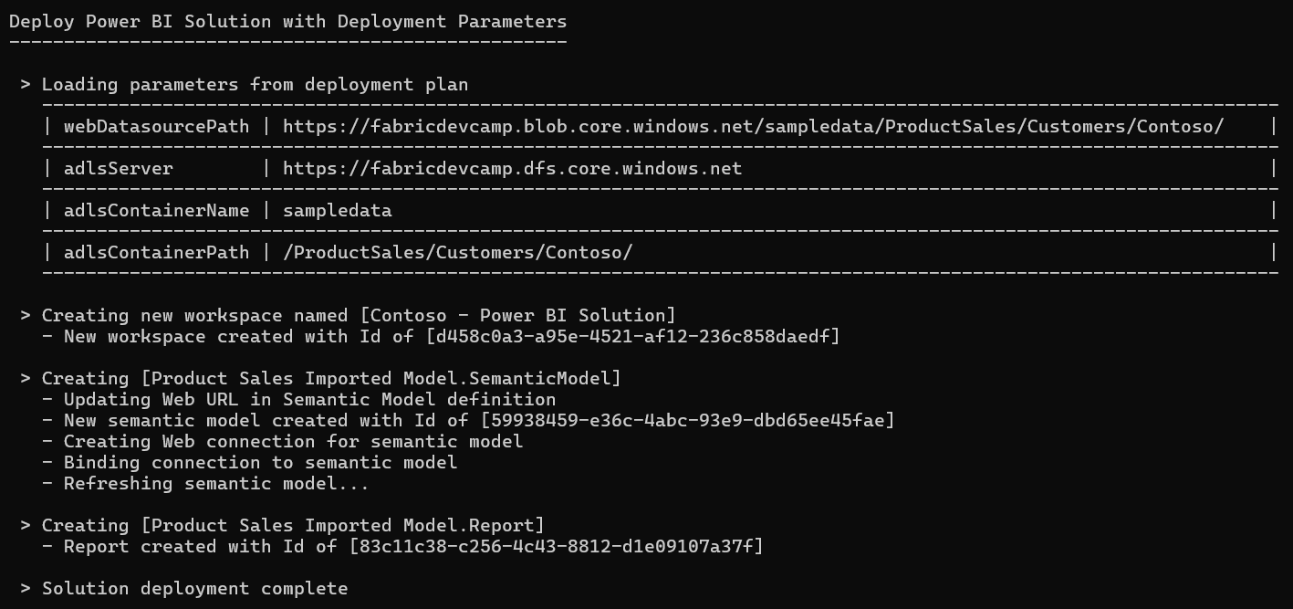

Slide 46
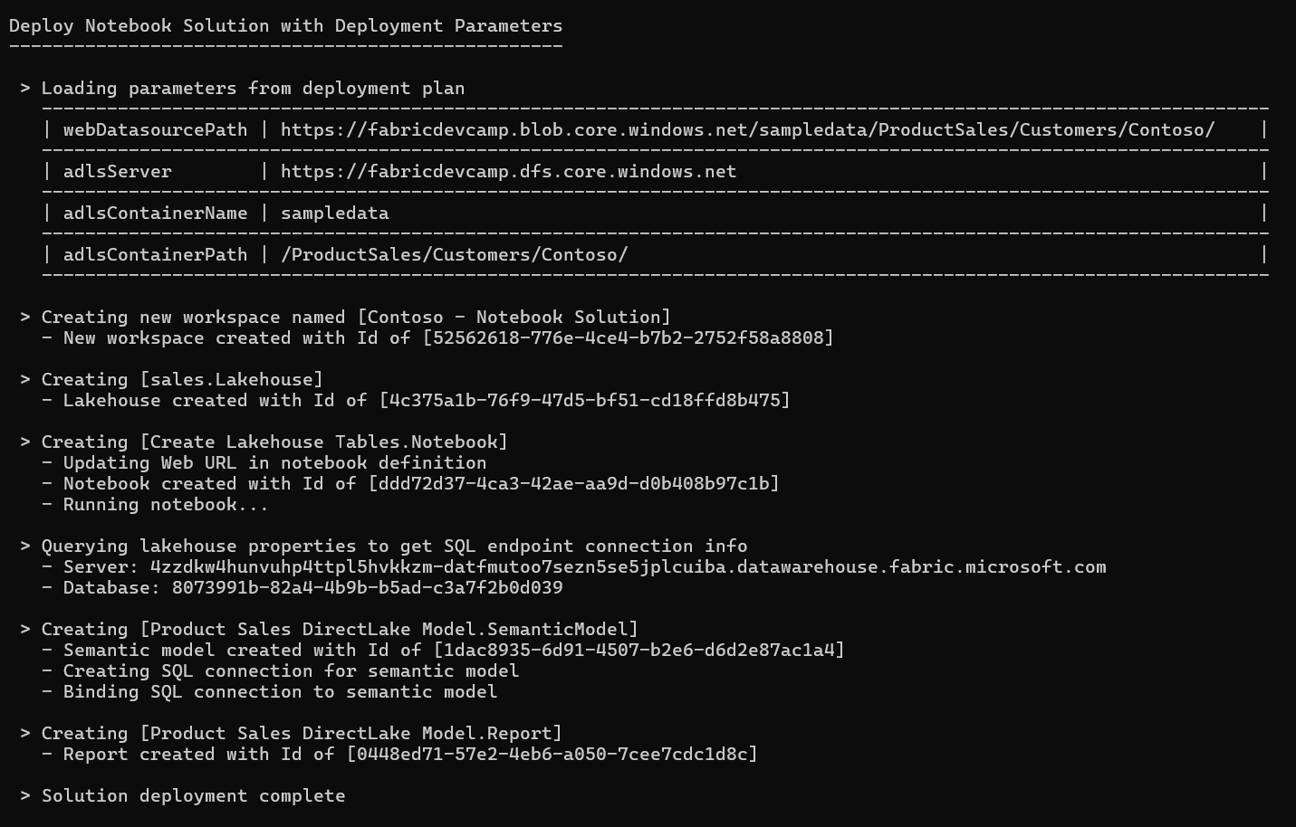

Slide 47
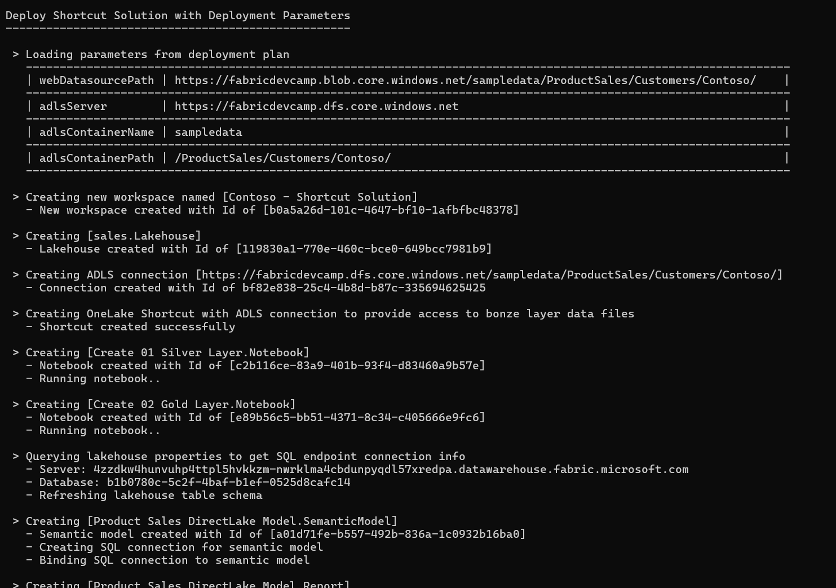


Slide 48
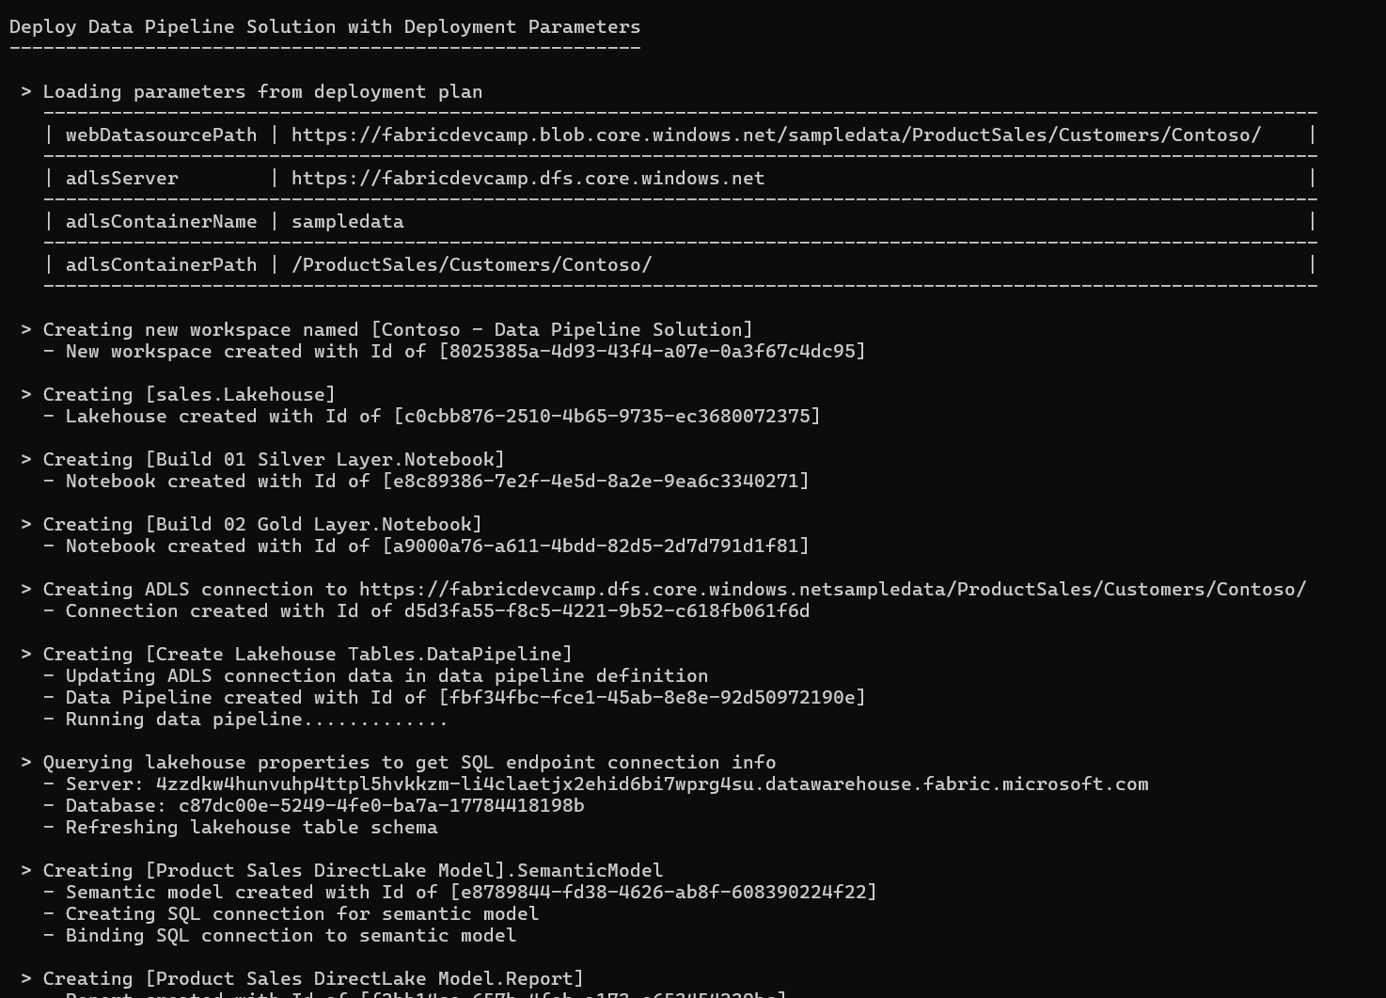


Slide 49
Where Do Datasource Paths Live in a Solution
Inside item definition files in semantic models
Example item definitions files with datasource paths include expressions.tmdl and model.bim
Inside Notebooks
Developers can add URLs directly in their python code
In connections
A connection is a credential bound to a datasource path
In shortcut
Shortcut created with datasource path
Shortcut must be bound to connection with same datasource path
In data pipeline
Data pipeline created to reference connection to external datasource
Connection created with target datasource path

Slide 50
Agenda
Introduction to Fabric Solution Deployment
Challenges in Fabric Solution Deployment
Implementing Workflows to Deloy Fabric Solutions
Integrating Deployment Parameters into CI/CD Workflows
Deploying and Updating Solutions from a Source Workspace
Implementing CI/CD using Staged Deployments
Managing Item Definitions using Fabric GIT Integration

Slide 51
Deploying Solution by Copying Items in Source Workspace
Fabric items can be cloned using item definitions
Retrieve item definition from source workspace by calling Get Item Definition
Manipulate content of item definition parts
Pass manipulated item definition to Create Item API to create new item
Pass manipulated item definition to Update Item Definition API to update existing item
Source
Workspace
Your Application
Target
Workspace
Item
Definition
Item
Definition
Create Item
Get Item Definition
Item
Definition
Update Item Definition

Slide 52
Deploy Solution from Source Workspace
Solution deployed from source workspace designed as solution template
Developer calls Get Item Definition on source workspace items
Developer modifies item definitions from source to redirect dependencies
Developer calls Create Item to create new item in solution workspace
Deploy Solution Logic

Slide 53
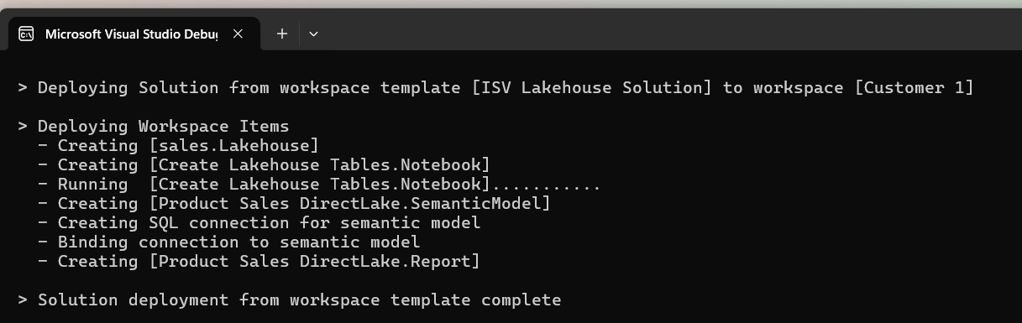
Deploy Solution Logic

Slide 54
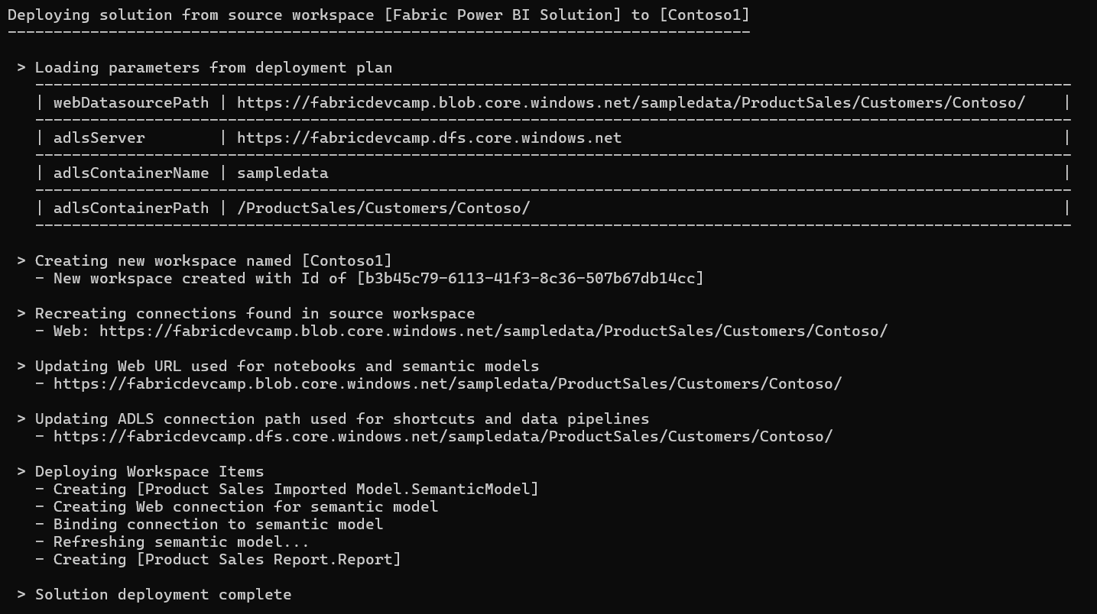

Slide 55
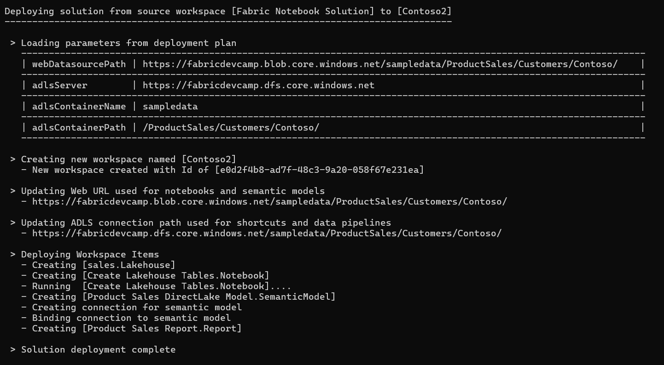

Slide 56
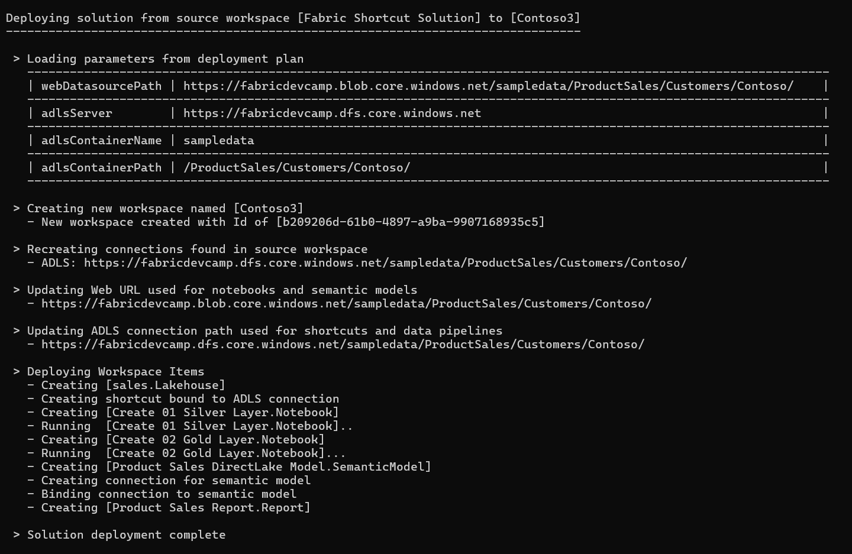

Slide 57
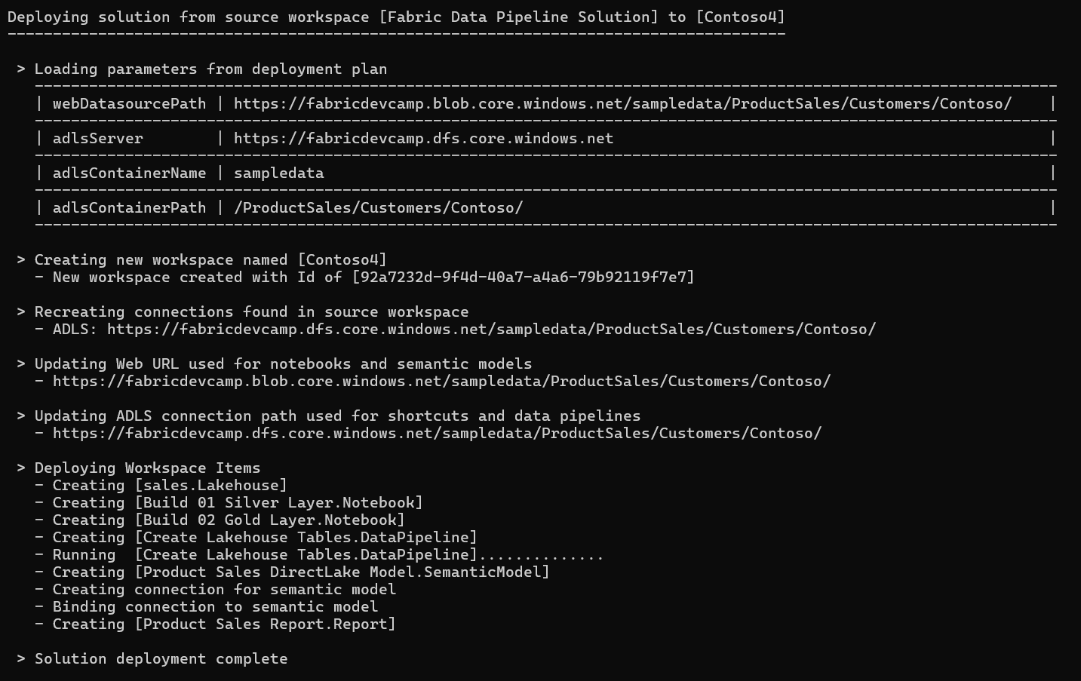

Slide 58
Update Solution from Source Workspace
Developer needs a way to update existing items with change in template workspace
Using delete and create operation is not good because it changes workspace item Id
Developer calls Update Item Definition to update solution items from template items
Update logic can create new workspace items recently added to workspace template
Update logic can delete orphaned items that do not exist in workspace template
Update Solution Logic

Slide 59
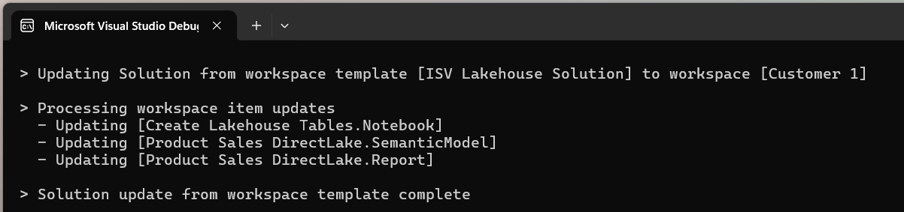
Update Solution Logic

Slide 60


Slide 61


Slide 62


Slide 63


Slide 64
Agenda
Introduction to Fabric Solution Deployment
Challenges in Fabric Solution Deployment
Implementing Workflows to Deloy Fabric Solutions
Integrating Deployment Parameters into CI/CD Workflows
Deploying and Updating Solutions from a Source Workspace
Implementing CI/CD using Staged Deployments
Managing Item Definitions using Fabric GIT Integration

Slide 65



Slide 66


Slide 67


Slide 68


Slide 69



Slide 70
Agenda
Introduction to Fabric Solution Deployment
Challenges in Fabric Solution Deployment
Implementing Workflows to Deloy Fabric Solutions
Integrating Deployment Parameters into CI/CD Workflows
Deploying and Updating Solutions from a Source Workspace
Implementing CI/CD using Staged Deployments
Managing Item Definitions using Fabric GIT Integration

Slide 71

Connecting Fabric Workspace to GIT Repositories
Fabric workspace can be connected to GIT repository
Fabric currently supports GIT repositories in Azure Dev Ops and GitHub
Workspace connections can be configured by hand or through Fabric REST APIs
Once connected, workspace items serialized as item definition files in GIT repository
GIT connection to workspace provides 2-way synchronization
Changes made to workspace items can be synchronized to GIT repository files
Changes committed to GIT repository files can be synchronized to workspace items
GIT
Sync

Slide 72


Workspace settings for Git Integration
Workspace can be connected to Azure Dev Ops repository from Workspace Settings
First, you need to create an Azure Dev Ops project and initialize its main repository
Create workspace connection to ADO repository using Git Integration tab in Workspace Settings dialog
Once connected, workspace items list shows Git status

Slide 73
Fabric GIT APIs
Fabric GIT APIs allow developer to automate creating workspace connections
Connect | Connect a specific workspace to a git repository and branch.
Disconnect | Disconnect a specific workspace from the Git repository and branch it is connected to.
Initialize Connection | Initialize a connection for a workspace that is connected to Git.
Get Connection | Returns git connection details for the specified workspace.
Commit To Git | Commits the changes made in the workspace to the connected remote branch.
Get Status | Returns the Git status of items in the workspace, that can be committed to Git.
Update From Git | Updates the workspace with commits pushed to the connected branch. ConflictResolutionPolicy helps to determine which way to sync: GIT->Workspace or Workspace->GIT
73
Microsoft Fabric
Notes:
Talk about selective commit , changes as part of roadmap
Mention irreversible nature of workspace update from GIT

Slide 74


Slide 75

Item Definitions maintained inside Git-enabled Repository

Slide 76
Summary
Introduction to Fabric Solution Deployment
Challenges in Fabric Solution Deployment
Implementing Workflows to Deloy Fabric Solutions
Integrating Deployment Parameters into CI/CD Workflows
Deploying and Updating Solutions from a Source Workspace
Implementing CI/CD using Staged Deployments
Managing Item Definitions using Fabric GIT Integration

Slide 77

Options for Creating Solution Template for Deployment
Option 1: Use a live workspace as the source solution template
Option 2: Use Fabric item definition files packaged in a solution folder
Fabric Solution Template
Solution Deployment Logic
Target
Workspace
Fabric Solution Template
Solution Deployment Logic
Target
Workspace

